Slide 1
WAZE&CO
services and consulting

Slide 2
Introduction
01
About us
02
Products & service
03
Team
04
Competitive Advantage
05
Achievements and Awards
06

Slide 3
رواد تأسيس المشروعات السياحية ,متخصصون فى تأسيس وتطوير مشروعات المطاعم والكافيهات ومشروعات الأغذيه ونعمل على توظيف خبراتنا المكتسبه على مدار سنوات طويله فى تطوير مشروعات ناجحه , وبالاضافه الى خبراتنا فى الادارة والتشغيل وهى أحد أهم عناصر النجاح لأى مشروع – فاننا نوفر أيضا الخدمات الأساسيه المطلوبه دائما للمشروعات سواء الجديده أو القائمه بالفعل .

Slide 4
About Us
WEAZ&CO We specialize in establishing all types of restaurants and Cafes. We implement our gained long experiences in developing successful projects. In addition to our management and operation expertise, which is one of the most important factors for the success of any business, we also provide basic services always in demand for existing or new projects.

Slide 5
Products & service
Restaurant & café project
Restaurant & café project The popularity of opening a new restaurant or a Café project has encouraged investors to venture into the food and beverage market drawn by an increasing demand from consumers and rewarding potential profit margins.
Feasibility Study
The true start for any restaurant of café project is a well-studied feasibility study.
Operations & management
Basics of Restaurant or Café management and operation
Running a restaurant or a café involves a lot of specific services and activities which we can deliver in full or partially as per your requirements.
Restaurant study and analysis, market and competition study, setting a work plan.
Setting the menu and suggesting alternatives or adding items (Menu Engineering).
Setting operation rules for the outlet, assessing product turnover, providing constant follow up and problem solving during work.
Providing a Recipe book for the items, setting the quality standards for the products and following up implementation.

Slide 6
Setting staff Budget, staff job specifications, required number, salaries, schedules and performance appraisal.
Conducting interviews and selecting hospitality staff candidates for all required specialties.
Providing theoretical and practical training for the staff and suggesting performance improvement steps for their jobs.
Devising sales plans and putting local and international marketing strategies.
Putting financial auditing principles into practice and adjusting cost variable elements.
Calculating & controlling food cost according to menu items and setting sales prices. Preparing accounting balance sheets, profit & loss and monthly reports.
Upgrade and Maximizing Profit Business
The program includes the following points:-
Performance analysis and assessment through sales figures and details.
Evaluation of the products and services.
Indicating available opportunities in the market.
Study of the main competitors.
Upgrading products through Menu engineering.
Adding signature products in demand by the clients.
Putting quality specifications and work strategy.

Slide 7
Training for the staff and management personnel.
Putting an operation manual
Suggesting activities and plans for local and International marketing.
Upgrade and Maximizing Profit Business
Training
Franchising

Slide 8
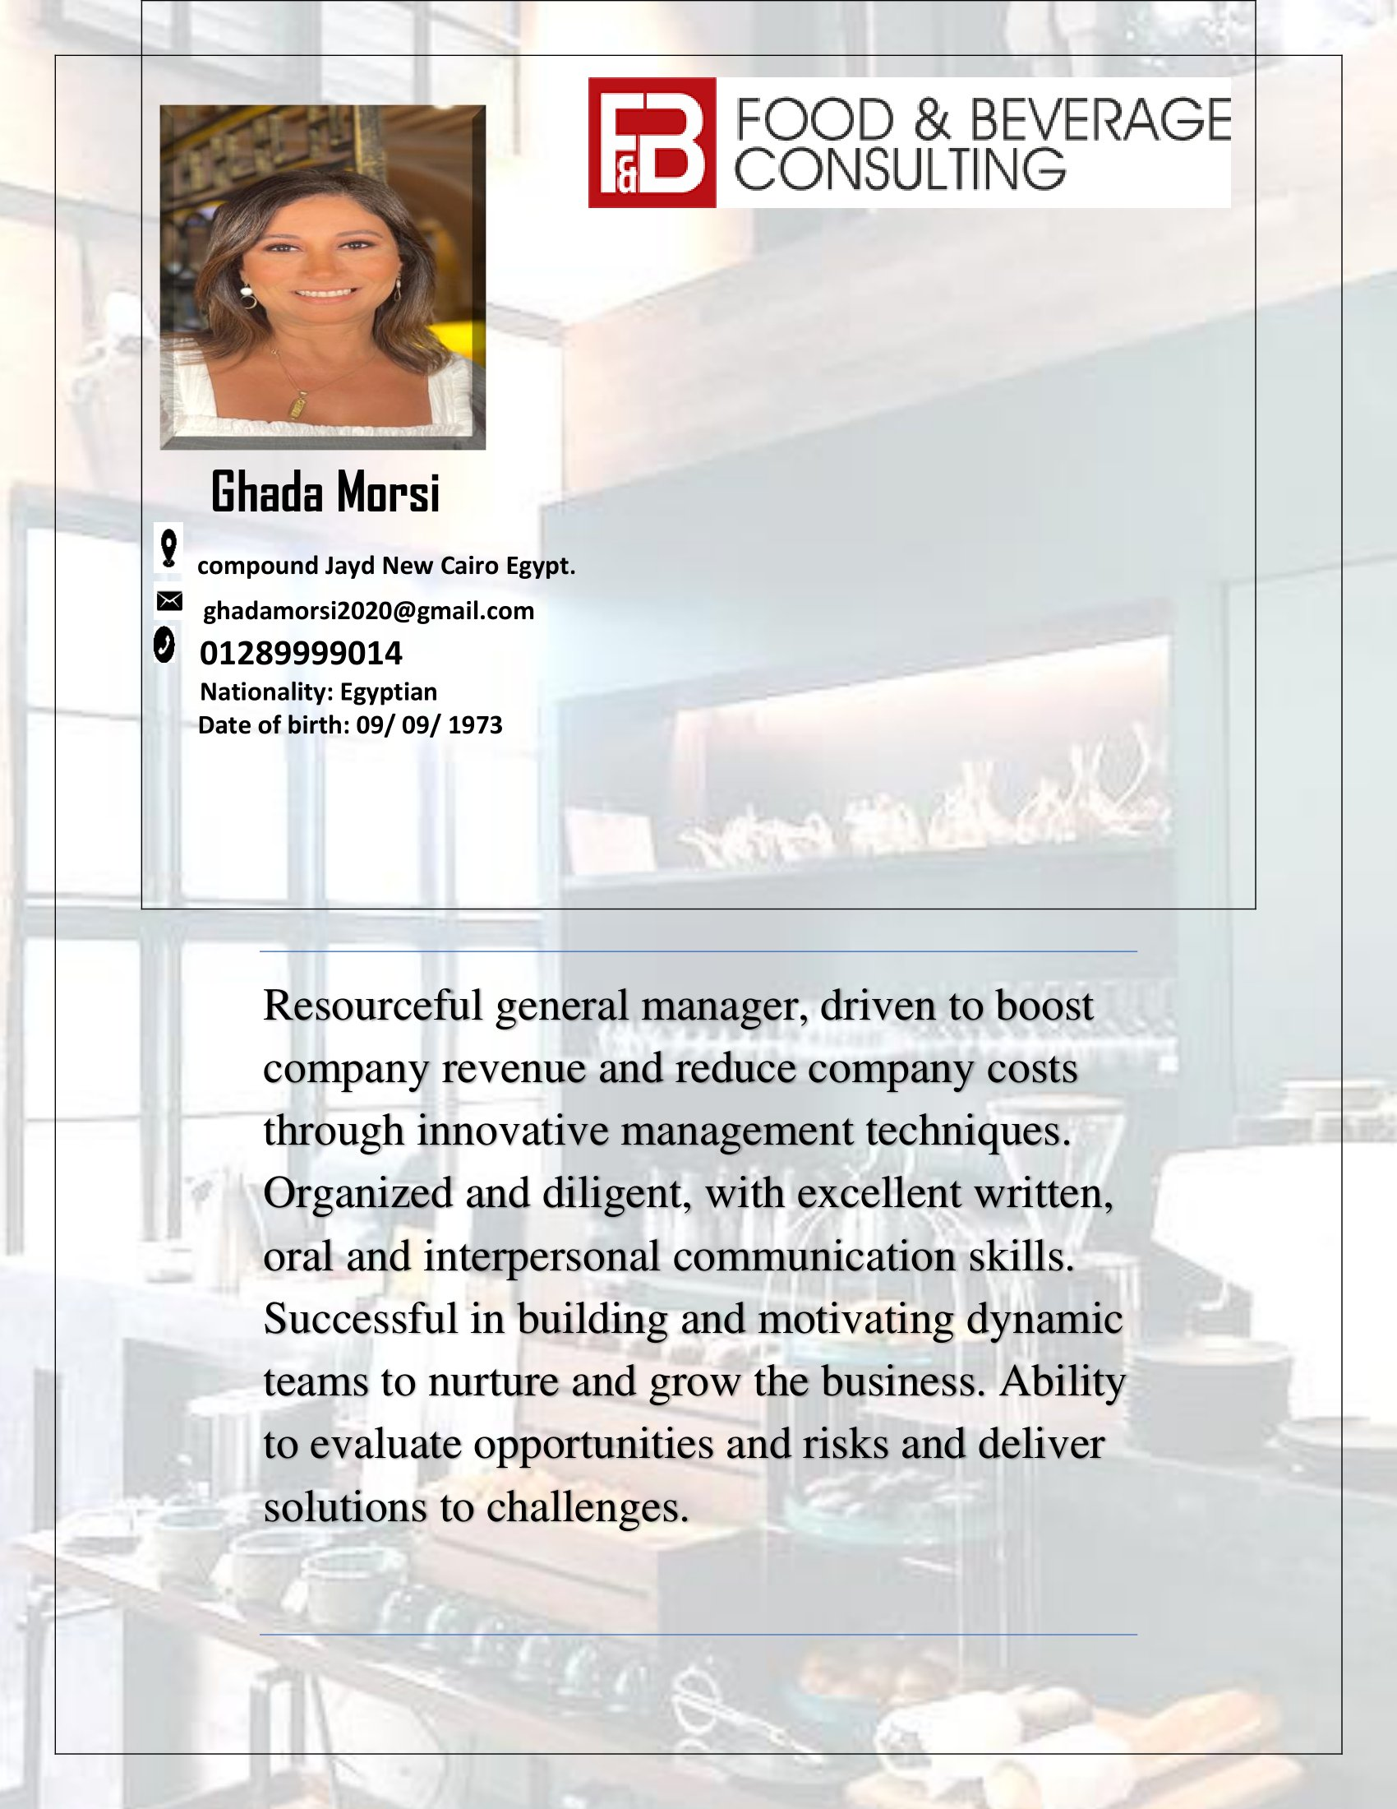
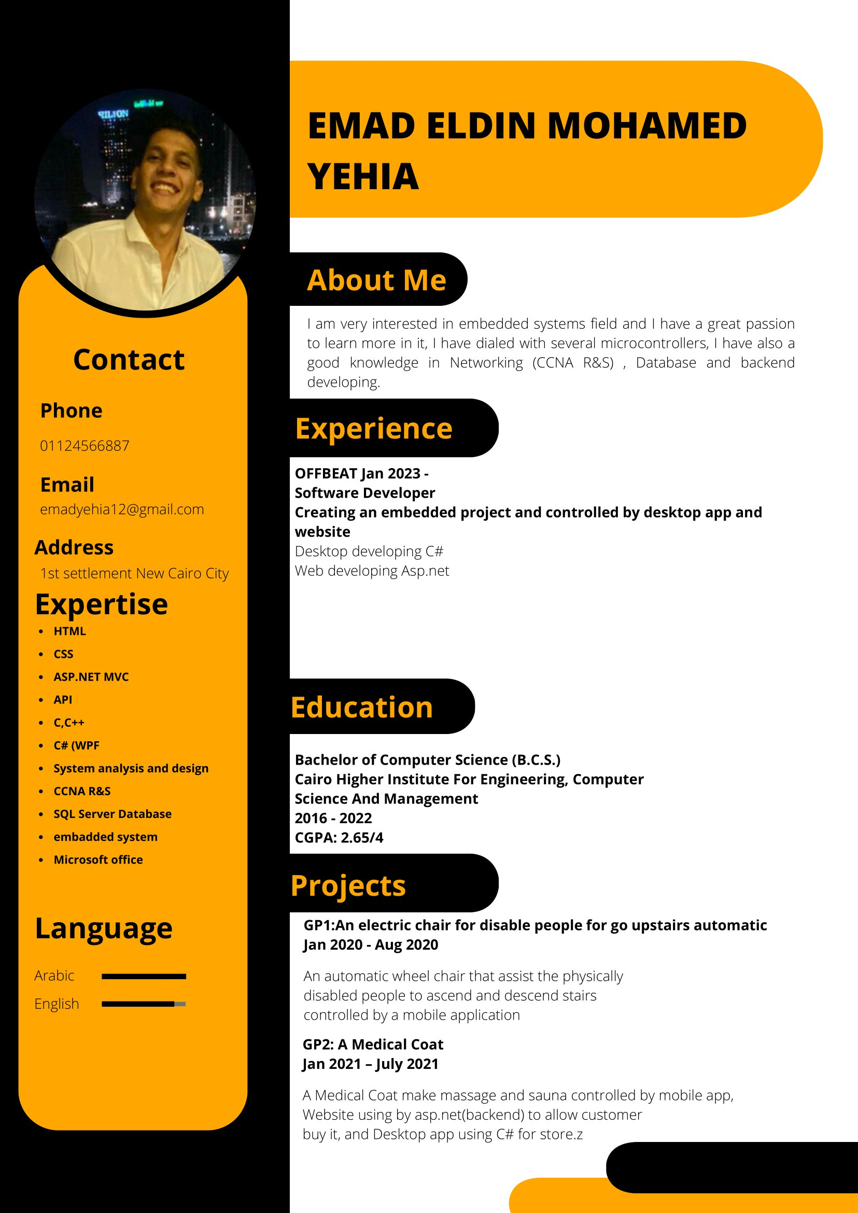
OUR TEAM
Ghada Morsi: Food & Beverage Consulting Eng:Emad Yehia (Software Engineer)

Slide 9
OUR TEAM
Mohamed Abdullatif : Accounting Manager
Mohamed ABDLLAH SNOSE: H-BARISTA
Sherif hossam Mohamed Mohamed : H-BARISTA

Slide 10
Competitive Advantage
branding
Whether you own a fine dining restaurant or a fast food establishment, your restaurant will have a competitive advantage if customers understand who you are and what kind of food you provide. If you are opening a fast food restaurant, develop a thorough understanding of your specialty and the type of customer you want to attract. Target your marketing efforts to reach these core customers. For example, if you specialize in local, sustainable food, consider a cross marketing campaign with your neighborhood farmers' market.
customer service
Because eating is such a personal experience, excellent customer service is vital for a restaurant to gain a competitive advantage. Treat all customers graciously and warmly, and get to know regulars by name. Ask your customers for feedback and show that you care about their responses by implementing changes based on the information you receive. Take complaints seriously and work to satisfy displeased customers in the short term while taking steps to avoid similar complaints in the long term.

Slide 11
location
Location is often a vital element in a restaurant's success. Choosing the right location at the outset can give your restaurant a competitive advantage from the beginning. Make sure the neighborhood where you open your restaurant is appropriate for the type of clientele you intent to attract. If you're opening a high end restaurant, you'll improve your chances of success if you locate it in an upper income neighborhood. A restaurant should also have plenty of on or off street parking or be located in an area with ample foot traffic.
quality and consistency
No matter how good your location and your marketing efforts, customers won't come to your restaurant if they don't enjoy your food. Your restaurant can gain a competitive advantage by paying close attention to quality and providing a consistent product that will make customers eager to return. Hire the right managers for your kitchen to ensure quality control of your ingredients, recipes and dishes. It is important to have hands-on managers who oversee all aspects of the kitchen, from the way raw food is stored to how chefs execute the dishes. Consistent high quality also attracts reviews and media attention, which provide invaluable exposure.

Slide 12
Achievements and Awards
Creating and managing many brands: Chez Edy, The Edward’s, Segafredo, Puccino’s, Pesto, kollak lo2ma, wrap a crêpe, The pizza truck, Alma, Lokoumades, Formula wonderful, Beit El komy, Lokmet el komy…
upgrading the food quality, display, hygiene standards and guest experience in EgyptAir VIP lounges at Cairo international airport (terminal 2 and 3) in addition to managing over 20 outlets inside the airport.
Target Group is the exclusive franchisor for the outstanding Italian brand Segafredo Zanetti Espresso since 2011 in consideration for our consistent commitment to the highest standards and procedures. Aviation field experience Inflight Service Manager, Lotus Air: Cairo, Egypt - 2006-2009]

